Slide 1
8085 Microprocessor
Architectural and assembly Language Programming of 8085

Slide 2
Introduction :
The 8085 microprocessor is an 8-bit microprocessor that was developed by Intel in the mid-1970s.
It was widely used in the early days of personal computing and was a popular choice for hobbyists and enthusiasts due to its simplicity and ease of use.
The architecture of the 8085 microprocessor consists of several key components, including the accumulator, registers, program counter, stack pointer, instruction register, flags register, data bus, address bus, and control bus.
The accumulator is an 8-bit register that is used to store arithmetic and logical results.
It is the most commonly used register in the 8085 microprocessor and is used to perform arithmetic and logical operations such as addition, subtraction, and bitwise operations.

Slide 3
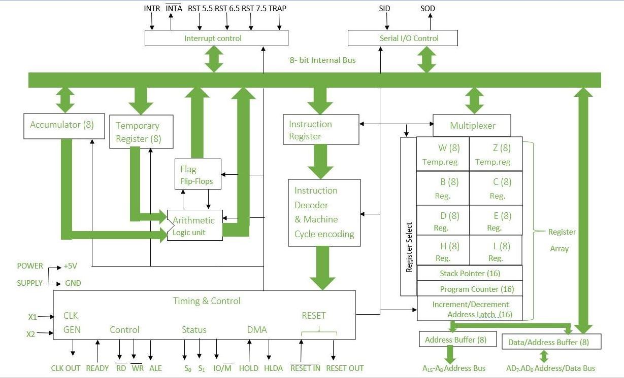
8085 is an 8-bit, General-purpose microprocessor. It consists of the following functional units:

Slide 4
1.Accumulator:
Accumulator is used to perform I/O, arithmetic, and logical operations.
It is connected to ALU and the internal data bus.
The accumulator is the heart of the microprocessor because for all arithmetic operations Accumulator’s 8-bit pin will always there be connected with ALU and in most-off times all the operations carried by different instructions will be stored in the accumulator after operation performance .
2.Temporary Register:
It is an 8-bit register that holds data values during arithmetic and logical operations.

Slide 5
3.Arithmetic and Logic Unit (ALU) :
It is used to perform mathematical operations like addition, multiplication, subtraction, division, decrement, increment, etc.
Different operations are carried out in ALU: Logical operations, Bit-Shifting Operations, and Arithmetic Operations.

Slide 6
4.Flags register
The flags register is an 8-bit register that contains status flags that indicate the result of an arithmetic or logical operation.
These flags include the carry flag, zero flag, sign flag, and parity flag, Auxiliary Carry Flag
The carry flag is set when an arithmetic operation generates a carry,
The zero flag is set when the result of an arithmetic or logical operation is zero,
The sign flag is set when the result of an arithmetic or logical operation is negative,
The parity flag is set when the result of an arithmetic or logical operation has an even number of 1 bits.

Slide 7
5.Instruction registers and decoder:
It is an 8-bit register that holds the instruction code that is being decoded. The instruction is fetched from the memory.

Slide 8
6.General-purpose registers
The 8085 microprocessor has six general-purpose registers, including B, C, D, E, H, and L, which can be combined to form 16-bit register pairs.
The B and C registers can be combined to form the BC register pair, the D and E registers can be combined to form the DE register pair, and the H and L registers can be combined to form the HL register pair.
These register pairs are commonly used to store memory addresses and other data.
The program counter is a 16-bit register that contains the memory address of the next instruction to be executed.
The program counter is incremented after each instruction is executed, which allows the microprocessor to execute instructions in sequence.

Slide 9
The stack pointer is a 16-bit register that is used to manage the stack.
The stack is a section of memory that is used to store data temporarily, such as subroutine addresses and other data.
The stack pointer is used to keep track of the top of the stack.
The instruction register is an 8-bit register that contains the current instruction being executed.
The instruction register is used by the microprocessor to decode and execute instructions.

Slide 10
7.Stack Pointer:
In stack, the content of the register is stored that is later used in the program.
It is a 16-bit special register.
The stack pointer is part of memory but it is part of Stack operations, unlike random memory access.
Stack pointer works in a continuous and contiguous part of the memory.
whereas Program Counter(PC) works in random memory locations.
This pointer is very useful in stack-related operations like PUSH, POP, and nested CALL requests initiated by Microprocessor. It reserves the address of the most recent stack entry.
8.Program Counter:
Program Counter holds the address value of the memory to the next instruction that is to be executed. It is a 16-bit register.
For Example: Suppose current value of Program Counter: [PC] = 4000H

Slide 11
9.Buses
Data Bus
The data bus is an 8-bit bus that is used to transfer data between the microprocessor and memory or other devices.
The Data bus is used to transfer data between the microprocessor and external devices such as memory and I/O devices.
The data bus is bidirectional, which means that it can be used to read data from memory or write data to memory.
The data bus is an 8-bit bus, allowing the 8085 to transfer 8-bit data at a time.
The data bus can also be used for instruction fetch operations, where the microprocessor fetches the instruction code from memory and decodes it.
The combination of the address bus and data bus allows the 8085 to communicate with and control external devices, allowing it to execute its program and perform various operations.

Slide 12
Address bus
The address bus is unidirectional and carries the location where data is to be stored.
The address bus is a 16-bit bus that is used to address memory and other devices.
The address bus is used to select the memory location or device that the microprocessor wants to access.
In the 8085 microprocessors, the address bus and data bus are two separate buses that are used for communication between the microprocessor and external devices.
The Address bus is used to transfer the memory address of the data that needs to be read or written.
The address bus is a 16-bit bus, allowing the 8085 to access up to 65,536 memory locations.

Slide 13
Control Bus
The control bus is a set of signals that controls the operations of the microprocessor, including the read and write operations.
The control bus includes signals such as the read signal, write signal, interrupt signal, and reset signal.
The read signal is used to read data from memory or other devices, the write signal is used to write data to memory or other devices, the interrupt signal is used to signal the microprocessor that an interrupt has occurred, and the reset signal is used to reset the microprocessor to its initial state.

Slide 14
10.Serial Input/output control:
It controls the serial data communication by using Serial input data and Serial output data.
Serial Input/Output control in the 8085 microprocessor refers to the communication of data between the microprocessor and external devices in a serial manner, i.e., one bit at a time.
The 8085 has a serial I/O port (SID/SOD) for serial communication.
The SID pin is used for serial input and the SOD pin is used for serial output.
The timing and control of serial communication is managed by the 8085’s internal circuitry.
The 8085 also has two special purpose registers, the Serial Control Register (SC) and the Serial Shift Register (SS), which are used to control and monitor the serial communication.

Slide 15
11.Interrupt control:
Whenever a microprocessor is executing the main program and if suddenly an interrupt occurs, the microprocessor shifts the control from the main program to process the incoming request.
After the request is completed, the control goes back to the main program.
There are 5 interrupt signals in 8085 microprocessors:
INTR,
TRAP,
RST 7.5,
RST 6.5, and
RST 5.5.
Priorities of Interrupts: TRAP > RST 7.5 > RST 6.5 > RST 5.5 > INTR

Slide 16
12.Timing and control unit:
The timing and control unit comes under the CPU section, and it controls the flow of data from the CPU to other devices.
It is also used to control the operations performed by the microprocessor and the devices connected to it.
There are certain timing and control signals like Control signals, DMA Signals, RESET signals and Status signals.

Slide 17
8085 Pin Diagram | Functional Pin Diagram of 8085 Microprocessor:
Fig. 1.3 (a) and (b) shows 8085 Pin Diagram and functional pin diagram of 8085 microprocessor respectively. The signals of 8085 Pin Diagram can be classified into seven groups according to their functions.
Power supply and frequency signals.
Data bus and address bus
Control bus
Interrupt signals
Serial I/O signals
DMA signals
Reset signals

Slide 18
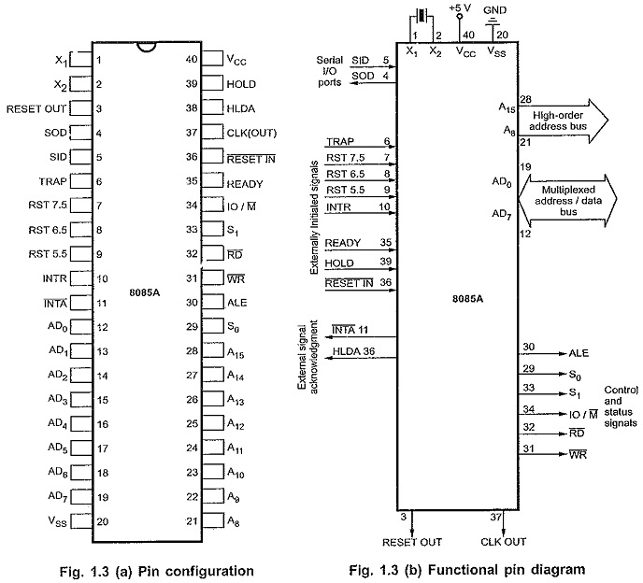
8085 Pin Diagram | Functional Pin Diagram of 8085 Microprocessor:

Slide 19
1. Power Supply and Frequency Signals:
V_{cc} : It requires a single +5 V power supply.
V_{ss} : Ground reference.
X₁ and X₂ : A tuned circuit like LC, RC or crystal is connected at these two The internal clock generator divides oscillator frequency by 2, therefore, to operate a system at 3 MHz, the crystal of tuned circuit must have a frequency of 6 MHz.
CLK OUT : This signal is used as a system clock for other devices. Its frequency is half the oscillator frequency.

Slide 20
2. Data Bus and Address Bus:
A) AD₀ to AD₇ : The 8 bit data bus (D₀ – D₇) is multiplexed with the lower half (A₀ – A₇) of the 16 bit address bus.
During first part of the machine cycle (T₁), lower 8 bits of memory address or I/O address appear on the bus.
During remaining part of the machine cycle (T₂ and T₃) these lines are used as a bi-directional data bus.
B) A₈ to A₁₅ : The upper half of the 16 bit address appears on the address lines A₈ to A₁₅.
These lines are exclusively used for the most significant 8 bits of the 16 bit address lines.

Slide 21
3. Control and Status Signals:
A) ALE (Address Latch Enable) : We, know that AD₀ to AD₇ lines are multiplexed and the lower half of address (A₀ – A₇) is available only during T₁ of the machine cycle.
This lower half of address is also necessary during T₂ and T₃ of machine cycle to access specific location in memory or I/O port.
This means that the lower half of an address must be latched in T₁ of the machine cycle, so that it is available throughout the machine cycle.
The latching of lower half of an address bus is done by using external latch and ALE signal from 8085 Pin Diagram.
B) RD and WR : These signals are basically used to control the direction of the data flow between processor and memory or I/O device/port. A low on RD indicates that the data must be read from the selected memory location or I/O port via data bus. A low on WR indicates that the data must be written into the selected memory location or I/O port via data bus.
C) IO/M, S₀ and S₁ : IO/M indicates whether I/O operation or memory operation is being carried out. S₁ and S₀ indicate the type of machine cycle in progress.
D) READY : It is used by the microprocessor to sense whether a peripheral is ready or not for data transfer. If not, the processor waits. It is thus used to synchronize slower peripherals to the microprocessor.

Slide 22
4. Interrupt Signals:
The 8085 Pin Diagram has five hardware interrupt signals : RST 5.5, RST 6.5, RST 7.5, TRAP and INTR.
The microprocessor recognizes interrupt requests on these lines at the end of the current instruction execution.
The INTA (Interrupt Acknowledge) signal is used to indicate that the processor has acknowledged an INTR interrupt.

Slide 23
5. Serial I/O Signals:
A) SID (Serial I/P Data) : This input signal is used to accept serial data bit by bit from the external device.
B) SOD (Serial O/P Data) : This is an output signal which enables the transmission of serial data bit by bit to the external device.

Slide 24
6. DMA Signal:
A) HOLD : This signal indicates that another master is requesting for the use of address bus, data bus and control bus.
B) HLDA : This active high signal is used to acknowledge HOLD request.

Slide 25
7. Reset Signals:
A) RESET IN : A low on this pin
Sets the program counter to zero (0000H).
Resets the interrupt enable and HLDA flip-flops.
Tri-states the data bus, address bus and control bus. (Note : Only during RESET is active).
Affects the contents of processor’s internal registers randomly.
On reset, the PC sets to 0000H which causes the 8085 Pin Diagram to execute the first instruction from address 0000H. For proper reset operation reset signal must be held low for at least 3 clock cycles. The power-on reset circuit can be used to ensure execution of first instruction from address 0000H.
B) RESET OUT :
This active high signal indicates that processor is being reset. This signal is synchronized to the processor clock and it can be used to reset other devices connected in the system.

Slide 26
Data transfer instructions in 8085 microprocessor
Data transfer instructions are the instructions that transfer data in the microprocessor.
OPCODE | OPERAND | EXPLANATION | No. of bytes | Machine cycles | No. of T-states | EXAMPLE
MOV | Rd, Rs | Rd = Rs | 1 | 1 opcode fetch | 4 | MOV A, B
MOV | Rd, M | Rd = Mc | 1 | 1 opcode fetch 1 memory read | 7 | MOV A, 2050
MOV | M, Rs | M = Rs | 1 | 1 opcode fetch 1 memory write | 7 | MOV 2050, A
MVI | Rd, 8-bit data | Rd = 8-bit data | 2 | 1 opcode fetch 1 memory read | 7 | MVI A, 50
MVI | M, 8-bit data | M = 8-bit data | 2 | 1 opcode fetch 1 memory read 1 memory write | 10 | MVI 2050, 50
LDA | 16-bi

Slide 27
STA | 16-bit address | contents at address = A | 3 | 1 opcode fetch 2 memory reads 1 memory write | 13 | STA 2050
LHLD | 16-bit address | directly loads at H & L registers | 3 | 1 opcode fetch 2 memory reads for reading 16-bit data 2 memory reads for loading H and L registers | 16 | LHLD 2050
PUSH | r.p. | pushes r.p. to the stack | 1 | 1 opcode fetch 2 memory writes | 12 | PUSH H
POP | r.p. | pops the stack to r.p. | 1 | 1 opcode fetch 2 memory reads | 10 | POP H
IN | 8-bit port address | inputs contents of the specified port to A | 2 | 1 opcode fetch 1 memory read 1 I/O read | 10 | IN 15
OUT | 8-bit port address | outputs contents of A to the specified port | 2 | 1 opcode fetch 1 memory read 1 I/O write | 10 | OUT 15

Slide 28
Arithmetic Instructions are the instructions which perform basic arithmetic operations such as addition, subtraction and a few more.
In 8085 microprocessor, the destination operand is generally the accumulator. Following is the table showing the list of arithmetic instructions:
Opcode | Operand | Explanation | Example
ADD | R | A = A + R | ADD B
ADD | M | A = A + Mc | ADD 2050
ADI | 8-bit data | A = A + 8-bit data | ADI 50
ADC | R | A = A + R + prev. carry | ADC B
ADC | M | A = A + Mc + prev. carry | ADC 2050
ACI | 8-bit data | A = A + 8-bit data + prev. carry | ACI 50
SUB | R | A = A – R | SUB B
SUB | M | A = A – Mc | SUB 2050

Slide 29
INR | R | R = R + 1 | INR B
INR | M | M = Mc + 1 | INR 2050
INX | r.p. | r.p. = r.p. + 1 | INX H
DCR | R | R = R – 1 | DCR B
DCR | M | M = Mc – 1 | DCR 2050

Slide 30
Logical instructions in the 8085 microprocessor are a set of instructions that perform logical operations on data in registers and memory.
Logical operations are operations that manipulate the bits of data without affecting their numerical value.
These operations include AND, OR, XOR, and NOT.
The logical instructions in the 8085 microprocessor include:
ANA – Logical AND: This instruction performs a logical AND operation between the accumulator and a specified register or memory location, and stores the result in the accumulator.
For example, the instruction “ANA B” performs a logical AND operation between the contents of the accumulator and the contents of the B register.
ORA – Logical OR: This instruction performs a logical OR operation between the accumulator and a specified register or memory location, and stores the result in the accumulator.
For example, the instruction “ORA C” performs a logical OR operation between the contents of the accumulator and the contents of the C register.

Slide 31
XRA – Logical XOR: This instruction performs a logical XOR operation between the accumulator and a specified register or memory location, and stores the result in the accumulator.
For example, the instruction “XRA M” performs a logical XOR operation between the contents of the accumulator and the contents of the memory location pointed to by the HL register.
CPL – Logical Complement: This instruction performs a logical complement operation on the contents of the accumulator.
This operation flips all the bits of the accumulator, effectively reversing its value.
CMA – Complement Accumulator: This instruction performs a bitwise complement operation on the contents of the accumulator.
This operation flips all the bits of the accumulator, effectively reversing its value.

Slide 32
Branching instructions refer to the act of switching execution to a different instruction sequence as a result of executing a branch instruction.
The three types of branching instructions are:
Jump (unconditional and conditional)
Call (unconditional and conditional)
Return (unconditional and conditional)

Slide 33
1. Jump Instructions – The jump instruction transfers the program sequence to the memory address given in the operand based on the specified flag.
Jump instructions are 2 types: Unconditional Jump Instructions and Conditional Jump Instructions.
(a) Unconditional Jump Instructions: Transfers the program sequence to the described memory address.
OPCODE | OPERAND | EXPLANATION | EXAMPLE
JMP | address | Jumps to the address | JMP 2050

Slide 34
(b) Conditional Jump Instructions: Transfers the program sequence to the described memory address only if the condition in satisfied.
OPCODE | OPERAND | EXPLANATION | EXAMPLE
JC | address | Jumps to the address if carry flag is 1 | JC 2050
JNC | address | Jumps to the address if carry flag is 0 | JNC 2050
JZ | address | Jumps to the address if zero flag is 1 | JZ 2050
JNZ | address | Jumps to the address if zero flag is 0 | JNZ 2050
JPE | address | Jumps to the address if parity flag is 1 | JPE 2050
JPO | address | Jumps to the address if parity flag is 0 | JPO 2050

Slide 35
2. Call Instructions – The call instruction transfers the program sequence to the memory address given in the operand.
Before transferring, the address of the next instruction after CALL is pushed onto the stack.
Call instructions are 2 types: Unconditional Call Instructions and Conditional Call Instructions.
(a) Unconditional Call Instructions: It transfers the program sequence to the memory address given in the operand.
OPCODE | OPERAND | EXPLANATION | EXAMPLE
CALL | address | Unconditionally calls | CALL 2050

Slide 36
b) Conditional Call Instructions: Only if the condition is satisfied, the instructions executes.
OPCODE | OPERAND | EXPLANATION | EXAMPLE
CC | address | Call if carry flag is 1 | CC 2050
CNC | address | Call if carry flag is 0 | CNC 2050
CZ | address | Calls if zero flag is 1 | CZ 2050
CNZ | address | Calls if zero flag is 0 | CNZ 2050
CPE | address | Calls if parity flag is 1 | CPE 2050
CPO | address | Calls if parity flag is 0 | CPO 2050
CM | address | Calls if sign flag is 1 | CM 2050

Slide 37
3. Return Instructions – The return instruction transfers the program sequence from the subroutine to the calling program. Return instructions are 2 types: Unconditional Jump Instructions and Conditional Jump Instructions.
(a) Unconditional Return Instruction: The program sequence is transferred unconditionally from the subroutine to the calling program
OPCODE | OPERAND | EXPLANATION | EXAMPLE
RET | none | Return from the subroutine unconditionally | RET

Slide 38
b) Conditional Return Instruction: The program sequence is transferred unconditionally from the subroutine to the calling program only is the condition is satisfied.
OPCODE | OPERAND | EXPLANATION | EXAMPLE
RC | none | Return from the subroutine if carry flag is 1 | RC
RNC | none | Return from the subroutine if carry flag is 0 | RNC
RZ | none | Return from the subroutine if zero flag is 1 | RZ
RNZ | none | Return from the subroutine if zero flag is 0 | RNZ
RPE | none | Return from the subroutine if parity flag is 1 | RPE
RPO | none | Return from the subroutine if parity flag is 0 | RPO

Slide 39
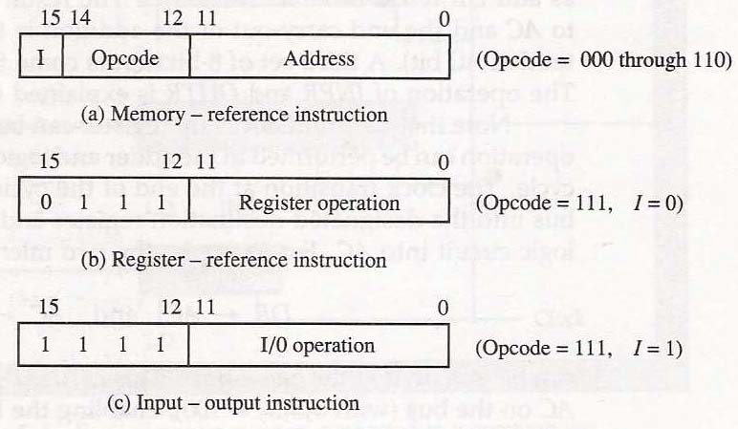
Opcode and Operands
Opcodes mean “operation codes”.
An opcode is the first part of an instruction that tells the computer what function to perform.
Every computer has an operation code or opcode for each of its functions.
It is an instruction that tells the processor what to do with the variable or data written beside it.
An operand is the second part of the instruction, which tells the computer where to find or store the data or instructions.
The number of operands varies among computers.
Each instruction tells the Control Unit of the CPU what to do and how to do it.
The operations are Arithmetic, Logical, Branch operation, etc depending upon the problem that is given to the computers.

Slide 40
Types of addressing modes –
In 8085 microprocessor there are 5 types of addressing modes:
Immediate Addressing Mode –
In immediate addressing mode the source operand is always data.
If the data is 8-bit, then the instruction will be of 2 bytes, if the data is of 16-bit then the instruction will be of 3 bytes.
Examples: MVI B 45 (move the data 45H immediately to register B) LXI H 3050 (load the H-L pair with the operand 3050H immediately) JMP address (jump to the operand address immediately)

Slide 41
Register Addressing Mode –
In register addressing mode, the data to be operated is available inside the register(s) and register(s) is(are) operands.
Therefore the operation is performed within various registers of the microprocessor.
Examples: MOV A, B (move the contents of register B to register A) ADD B (add contents of registers A and B and store the result in register A) INR A (increment the contents of register A by one)

Slide 42
Direct Addressing Mode –
In direct addressing mode, the data to be operated is available inside a memory location and that memory location is directly specified as an operand.
The operand is directly available in the instruction itself.
Examples: LDA 2050 (load the contents of memory location into accumulator A) LHLD address (load contents of 16-bit memory location into H-L register pair) IN 35 (read the data from port whose address is 35)

Slide 43
Register Indirect Addressing Mode –
In register indirect addressing mode, the data to be operated is available inside a memory location and that memory location is indirectly specified by a register pair.
Examples: MOV A, M (move the contents of the memory location pointed by the H-L pair to the accumulator) LDAX B (move contents of B-C register to the accumulator) STAX B (store accumulator contents in memory pointed by register pair B-C)

Slide 44
Implied/Implicit Addressing Mode – In implied/implicit addressing mode the operand is hidden and the data to be operated is available in the instruction itself.
Examples: CMA (finds and stores the 1’s complement of the contents of accumulator A in A) RRC (rotate accumulator A right by one bit) RLC (rotate accumulator A left by one bit)
Relative Addressing Mode:
In this mode, the operand is a memory location specified by the contents of the program counter plus a constant value.
example:
MOV R0,#05H AGAIN: MVI A,#55H ADD A,R0 JMP AGAIN

Slide 45
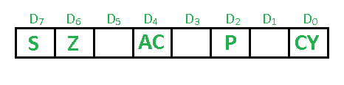
Flag of 8085 microprocessor The Flag register is a Special Purpose Register.
Depending upon the value of the result after any arithmetic and logical operation, the flag bits become set (1) or reset (0).
In 8085 microprocessor, the flag register consists of 8 bits and only 5 of them are useful. The 5 flags are:

Slide 46
Sign Flag (S) –
After any operation if the MSB (B(7)) of the result is 1, it indicates the number is negative and the sign flag becomes set, i.e. 1.
If the MSB is 0, it indicates the number is positive and the sign flag becomes reset i.e. 0.
from 00H to 7F, sign flag is 0 from 80H to FF, sign flag is 1 1- MSB is 1 (negative) 0- MSB is 0 (positive)
Example: MVI A 30 (load 30H in register A) MVI B 40 (load 40H in register B) SUB B (A = A – B) These set of instructions will set the sign flag to 1 as 30 – 40 is a negative number.
MVI A 40 (load 40H in register A) MVI B 30 (load 30H in register B) SUB B (A = A – B) These set of instructions will reset the sign flag to 0 as 40 – 30 is a positive number.

Slide 47
Zero Flag (Z) –
After any arithmetical or logical operation if the result is 0 (00)H, the zero flag becomes set i.e. 1,
otherwise it becomes reset i.e. 0. 00H zero flags is 1.
from 01H to FFH zero flag is 0 1- zero-result 0- non-zero result
Example: MVI A 10 (load 10H in register A) SUB A (A = A – A) These set of instructions will set the zero flag to 1 as 10H – 10H is 00H

Slide 48
Auxiliary Carry Flag (AC) –
This flag is used in the BCD number system(0-9).
If after any arithmetic or logical operation D(3) generates any carry and passes it on to D(4) this flag becomes set i.e. 1, otherwise, it becomes reset i.e. 0.
This is the only flag register that is not accessible by the programmer 1-carry out from bit 3 on addition or borrows into bit 3 on subtraction 0-otherwise .
Example: MVI A 2BH (load 2BH in register A) MVI 39H (load 39H in register B) ADD B (A = A + B) These set of instructions will set the auxiliary carry flag to 1, as on adding 2B and 39, the addition of lower-order nibbles B and 9 will generate a carry.

Slide 49
Parity Flag (P) –
If after any arithmetic or logical operation the result has even parity, an even number of 1 bit, the parity register becomes set i.e. 1, otherwise it becomes reset i.e. 0.
1-accumulator has an even number of 1 bits 0-accumulator has odd parity
Example: MVI A 05 (load 05H in register A) This instruction will set the parity flag to 1 as the BCD code of 05H is 00000101, which contains an even number of ones i.e. 2.

Slide 50
Carry Flag (CY) –
Carry is generated when performing n bit operations and the result is more than n bits, then this flag becomes set i.e. 1, otherwise, it becomes reset i.e. 0.
During subtraction (A-B), if A>B it becomes reset, and if (A<B) it becomes set.
Carry flag is also called the borrow flag. 1-carry out from MSB bit on addition or borrow into MSB bit on subtraction 0-no carry out or borrow into MSB bit.
Example: MVI A 30 (load 30H in register A) MVI B 40 (load 40H in register B) SUB B (A = A – B) These set of instructions will set the carry flag to 1 as 30 – 40 generates a carry/borrow.
MVI A 40 (load 40H in register A) MVI B 30 (load 30H in register B) SUB B (A = A – B) These set of instructions will reset the carry flag to 0 as 40 – 30 does not generate any carry/borrow.

Slide 51
Interrupt signals
In the 8085 microprocessor, an interrupt is a signal that temporarily suspends the normal execution of a program and redirects the control to a specific interrupt service routine (ISR).
Interrupts allow the microprocessor to respond to external events, such as user input, system events, or hardware signals, without the need for constant polling.
There are five interrupt signals in the 8085 microprocessor:
TRAP:
The TRAP interrupt is a non-maskable interrupt that is generated by an external device, such as a power failure or a hardware malfunction.
The TRAP interrupt has the highest priority and cannot be disabled.
2.RST 7.5: The RST 7.5 interrupt is a maskable interrupt that is generated by a software instruction.
It has the second highest priority.

Slide 52
3.RST 6.5: The RST 6.5 interrupt is a maskable interrupt that is generated by a software instruction.
It has the third highest priority.
4.RST 5.5: The RST 5.5 interrupt is a maskable interrupt that is generated by a software instruction.
It has the fourth highest priority.
5.INTR: The INTR interrupt is a maskable interrupt that is generated by an external device, such as a keyboard or a mouse.
It has the lowest priority and can be disabled.
When microprocessor receives any interrupt signal from peripheral(s) which are requesting its services, it stops its current execution and program control is transferred to a sub-routine by generating CALL signal and after executing sub-routine by generating RET signal again program control is transferred to main program from where it had stopped.
When microprocessor receives interrupt signals, it sends an acknowledgement (INTA) to the peripheral which is requesting for its service.
Interrupts can be classified into various categories based on different parameters:

Slide 53
Instruction cycle in 8085 microprocessor
Introduction :
The 8085 microprocessor is a popular 8-bit microprocessor that was first introduced by Intel in 1976.
It has a set of instructions that it can execute, and the execution of each instruction involves a series of steps known as the instruction cycle.
The instruction cycle of the 8085 microprocessor consists of four basic steps, which are:
Fetch: In this step, the microprocessor fetches the instruction from the memory location pointed to by the program counter (PC). The PC is incremented by one after the fetch operation.
Decode: Once the instruction is fetched, the microprocessor decodes it to determine the operation to be performed and the operands involved.
Execute: In this step, the microprocessor performs the operation specified by the instruction on the operands.
Store: Finally, the result of the execution is stored in the appropriate memory location or register.
Once the execution of an instruction is complete, the microprocessor returns to the fetch step to fetch the next instruction to be executed.
This cycle repeats until the program is complete or interrupted.

Slide 54
Time diagram
Time diagram is a graphical representation where the 8085 instruction timing diagram represents the execution time of each instruction in graphical format.
we will be Going Through the Timing Diagram, We will go through Different Machine Cycles Such as
Opcode Fetch,
Memory Read,
Memory Write,
I/O Read, and I/O Write,

Slide 55
Clock Signal: The time required to execute an instruction is called a clock cycle.
Instruction cycle: Time required to execute and fetch an entire instruction is called instruction cycle.
Machine Cycle: The time required to access memory or input/output devices is called a machine cycle. The 8085 has 5 basic machine cycles i.e., load opcode, read from memory, write to memory, read I/O, and write I/O.
T-State: A machine cycle and an instruction cycle take several clock periods. The portion of an operation performed in one system clock period is called a T-state.
Control Signals: The control signal controls the operations. Common signals are ALE (address block enable), RD (read), WR (write), and IO/M (input/output) memory.

Slide 56
Machine Cycle of 8085
The 8085 microprocessor has 5 basic machine cycles. They are :
Opcode Fetch {4T- state}
Memory Read {3T- state}
Memory Write {3T- state}
I/O Read {3T- state}
I/O Write {3T- state}

Slide 57
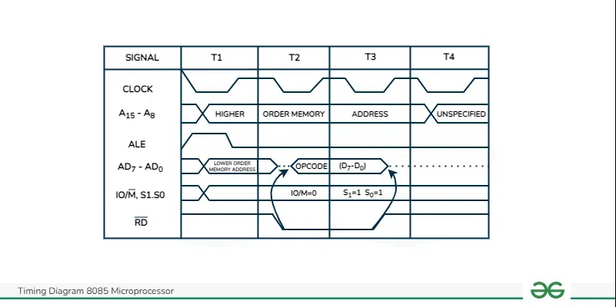
Opcode Fetch Machine Cycle of 8085
Each processor instruction has a one byte opcode.
Operation codes are stored in memory. Thus, the performs an opcode load machine cycle to load the opcode from memory.
Thus, each instruction begins with a machine cycle of opcodes.
The time the processor takes to perform an opcode load cycle is 4T.
At this time, the first, 3T-states are used to load the opcode from memory, and the remaining T-states are used for internal opcodes.

